Slide 1
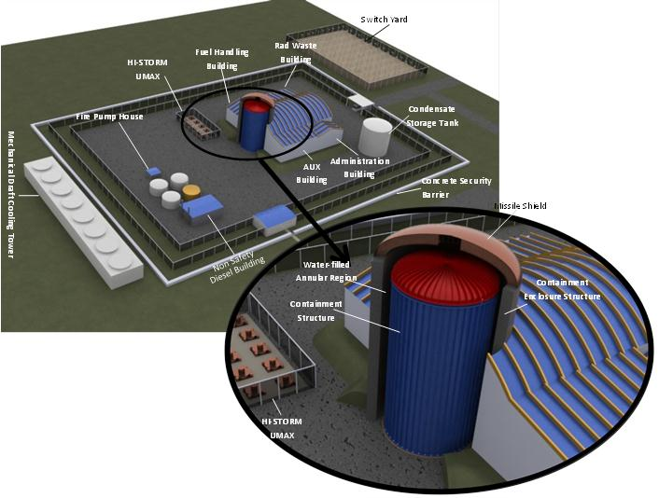
SMR-160: A Walk-away Safe Small Modular Nuclear Reactor
By
Dr. Kris Singh
President & CEO
Holtec International
May 29, 2013
Washington, D.C.

Slide 2
Overview of SM-160
SMR-160 is a 160 MW(e) small modular reactor being developed by Holtec International’s wholly owned subsidiary SMR, LLC.
Our design goal for SMR-160 is to make the reactor so safe and secure from the vagaries of nature or mendacity of man that it can be safely deployed adjacent to population centers.
To achieve supreme safety and security, a complex rethink of the nuclear plant’s anatomy is required. The resulting design of SMR-160, instructed by six decades of commercial nuclear experience, is vastly dissimilar from the present day reactors.

Slide 3
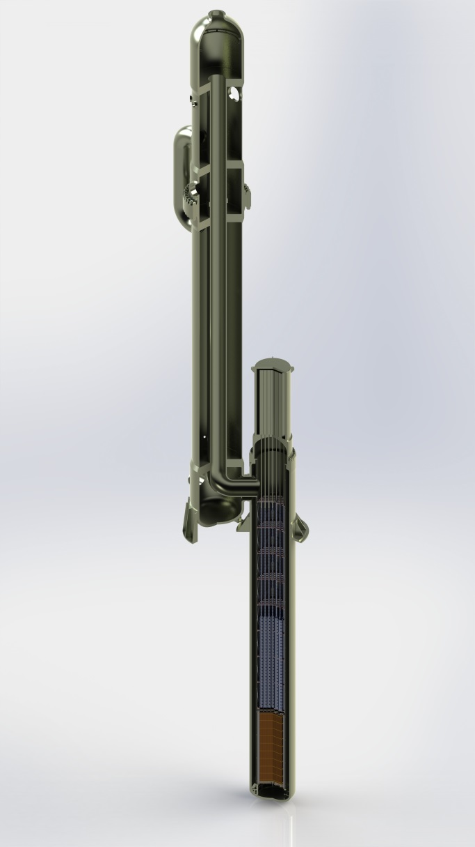
Innovations in the NSSS for Operational Reliability
SMR-160 is a small modular reactor because the largest reactor that we could devise that fulfilled our criteria for unconditional safety and security is 160MW(e)
SMR-160 is a PWR that uses a BWR fuel each equipped with Fuel Channel
Steam generator is mounted adjacent to the reactor vessel without any interconnecting piping (a Holtec Patent).

Slide 4

Innovations in the NSSS for Operational Reliability
FLOW TURNS INTO THE TUBES OF THE HEAT EXCHANGER STACK
Steam generator secondary side consists of pre-heating, boiling and superheating sections arranged in counter-current flow with the reactor coolant with design features to minimize internal stresses (Holtec Patent).
Steam generator contributes to the thermosiphon pressure head (aggregate pressure driver ≈ 6 psi. High pressure head guarantees turbulent flow in the reactor core (essential for predictable performance).
Pressurizer situated at the top of the steam generator column.
PRESSURIZER
COOLANT COOLS FLOWING DOWN SUPERHEATER TUBES
(SUPERHEATING STEAM ON SHELLSIDE)
SUPERHEATED
STEAM OUT
SUPERHEATER
HOT COOLANT RISES TO THE TOP OF STACK THROUGH CENTRAL RISER
COOLANT COOLS FLOWING DOWN STEAM GENERATOR TUBES
(PRODUCING STEAM ON SHELLSIDE)
STEAM GENERATOR
FEEDWATER
IN
HOT COOLANT ENTERS THE HEAT EXCHANGER STACK
COLD COOLANT FLOWS BACK DOWN THROUGH DOWNCOMER REGION
REACTOR VESSEL
HOT COOLANT RISES FROM THE CORE

Slide 5
SMR 160 Design Attributes
Multiple SMR-160s can be installed at one site.
Each unit is Autonomous
Small footprint, under 5 Acres
Short time to commissioning, ~2 Years
All nuclear commodities (core & spent fuel in the pool) are deep underground & protected from missiles.
Approx. 3.5 years refueling cycle
Cartridge ensures short outage durations ≈ 5 days
Used fuel stored at site in inconspicuous underground cavities after a mere 3 years of decay

Slide 6
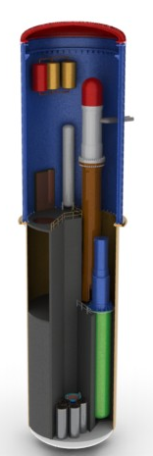
Design Features Configured for Utmost Safety & Security
The reactor core is located deep underground.
Because the reactor water is unborated it has a strong negative reactivity coefficient, the reactor becomes subcritical as soon as the water temperature in the core begins to rise above the design point.
Core is cooled under all scenarios (normal operating or forced shut down) by gravitational action (no pumps!).
The containment is a missile-resistant steel structure that efficiently dissipates heat to the environment (Holtec Patent) to an external reservoir of water.
The external reservoir serves as the ultimate heat sink for all waste plant heat (Holtec Patent).
Elevation 91’
Elevation 0’
Elevation -43’
Elevation -105’
Front Section
View

Slide 7
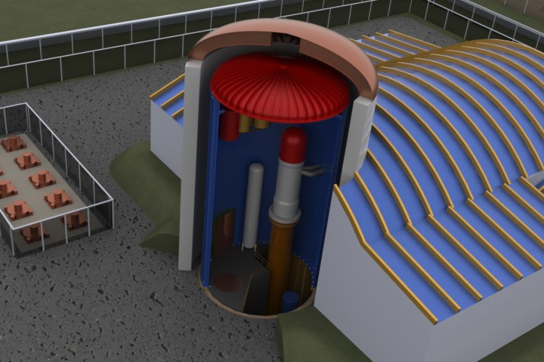

Design Features Configured for Utmost Safety & Security
Containment has few penetrations.
Large pipe break Loss of Coolant Accident (LOCA) rendered non-credible by design: no large piping in the Reactor Coolant System (RCS) loop.
Double structural protection against crashing aircraft. Fuel is protected by airplane crash resistant Containment Enclosure Structure(CES) and by Containment Building.
Containment
Enclosure Structure (CES)
Water Filled
Annular Region
Onsite Underground Used Fuel Storage Facility
Containment
Structure (CS)
Core Located
Deep Underground

Slide 8
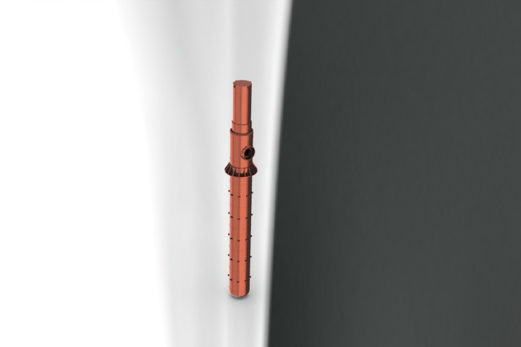
Design Features Configured for Utmost Safety & Security
The Containment & its internals designed to withstand the strongest Design Basis Earthquake postulated for (virtually) all existing U.S. nuclear plant locations.
Tall column of water above the reactor core – large coolant inventory. No penetration in the RV for the bottom 45 ft.
The RCS, fuel pool and small break LOCA are passively cooled during a station black out event.
Containment remains passively self-cooling indefinitely after a LOCA or a station black-out.
Post-LOCA peak pressure is reduced to 50% of its peak value in less than two hours by purely passive action(regulatory requirement is 24 hours).
All safety systems are located inside the containment.
Diesel power used only for non-safety functions such as start up and for DC battery charging.
All safety-related valves engineered to activate automatically (fail safe) upon loss of power.

Slide 9
Design Features Configured for Utmost Safety & Security
Enhanced Operational Features (cont’d)
In-containment wet storage of spent fuel.
Fuel stored in “cartridge” form in the pool, decay heat removed by an innovative passive design (no pump or fuel pool cooler required) (Holtec Patent)
air cooled condenser option is available.
Integral pressurizer (eliminate large external piping).
Steam generation with superheating to maximize turbine blade life.
No boron in the reactor coolant in normal operation (to simplify system operations and mitigate internal corrosion/crud formation in the reactor system).
The Containment can maintain safe configuration after LOCA indefinitely. The water inventory in the reactor vessel will be maintained without any time limit.
No boron in spent fuel pool.
Integral Pressurizer
Super Heater
Steam Generator
Elevation 0’
Elevation -43’
Elevation 105’
Front Section
View

Slide 10
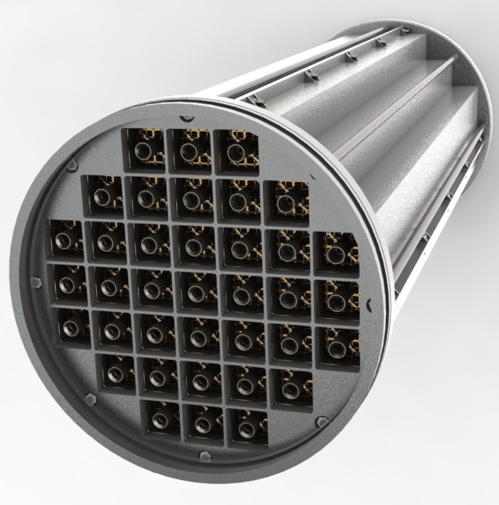
Design Features Configured for Utmost Safety & Security
Fuel packaged in a Unitary Cartridge (Holtec Patent)
Refueling occurs by changing out a single cartridge that facilitates rapid refueling.
Specialized tooling required to remove fuel
Design hardened against security threats
Fuel Cartridge is a multi-function device; it serves as:
a fuel rack in the pool
a “fuel basket” for dry storage
Low turbulence in the Core protects fuel from fretting damage.

Slide 11
Design Features Configured for Utmost Safety & Security
Underground location of safety systems to provide:
Immunity from external natural events.
Maximum protection from malevolent human intervention.
Minimum occupational and off-site dose.
In the event of a station black-out (Fukushima accident), the reactor’s post-scram heat is rejected to the atmosphere by purely passive means (Holtec patent):The Containment is “Fukushima-proof”.
Even a postulated massive cracking of the fuel pool structure (such as Fukushima after the earthquake) will not expose fuel to a dry condition (a Holtec Patent). The Fuel Pool Containment Structure is made of steel which precludes the risk of cracking and loss of water after a cataclysmic event such as an earthquake).

Slide 12
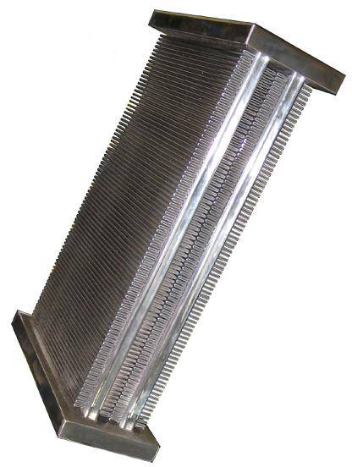
An Overview of SMR-160 Key Technology Differentiators (cont’d)
SMR-160’s non-safety waste heat rejection can be directly to air (reliance on a natural water source for cooling virtually eliminated, if desired).
Holtec provides innovative air cooled condensers in two configurations:
HI-MAX which is a horizontal A-frame design (presently commercially sold by the Company).
HI-VACC which stands for Holtec International Vertical Air Cooled Condenser
HI-MAX™ SS – Stainless Steel tubes
with aluminum fins (Holtec Patent)
HI-VACC

Slide 13
Innovative Features in the SMR-160 Power Cycle Design Objectives
Enhance natural circulation in the core
Minimize RCS return water temperature and maximize buoyancy head
Minimize primary loop pressure drop and maximize core circulation
No Reactor Coolant pumps
Cycle efficiency over 30% (Turbine Power Output – MW / Reactor Thermal Power MWt)
Integrate steam superheating in the power cycle
Maximize turbine blade life
Turbine blade damage prevented using superheated steam.
Simplified Steam Cycle for enhanced reliability

Slide 14
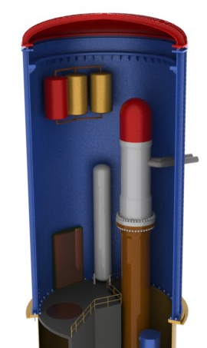
Concluding Remarks
SMR-160 is 160 MWe and is engineered to provide a safe, reliable, and secure source of electric power.
Distributed power generation eliminates reliance on a robust transmission grid.
Thanks to gravity-driven primary flow, the power plant is thermally suited for “load following”.
Depletion of water in the reactor vessel after a postulated LOCA not credible, which ensures utmost safety.
Black start capable.
Generation capacity at a site can be incrementally increased by adding units.

Slide 15

Our Ultimate Mission
Our ultimate mission is to light up the ill-lit areas of the globe with affordable pollution-free energy through hundreds of SMR-160s operating around the world.

